Slide 1
Biomechanics Labs for K-12
Need clarifications on slides: 2, 11, 15, 20, 21, and 28

Slide 2
Optimal Projection for Maximizing Distance
Movements involving projectiles have an optimal angle of release to maximize distance depending on:
Release height versus target height
45º is optimal if the release point and landing point are the same height.
Greater than 45º will result in shorter distance, greater height, and greater flight time
Less than 45º will result in shorter distances, lower height, and shorter flight time
Most throwing and striking skills have an optimal angle of projection below 45⁰.
Velocity of object released
Lower velocity vs higher velocity? How does distance impact angle of release?

Slide 3
Optimal Projection 1
You will be throwing an object (i.e., a baseball) from different release angles and recording the flight time and distance. |  | Flight Time | Distance
High angle of release
Moderate angle of release
Low angle of release
Low angle of release = Faster but less distance (ie. baseball throw from the infield to home plate) High angle of release = More distance but longer flight time (ie. baseball throw from the outfield to home plate)
Notes:
Varies the speed, force and trajectory of the shot based on location of the object in relation to the target. (S2.M9.8)

Slide 4
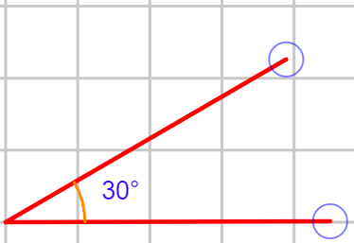
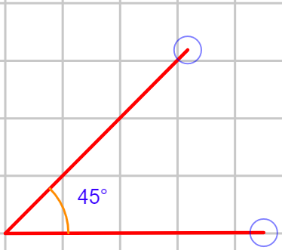
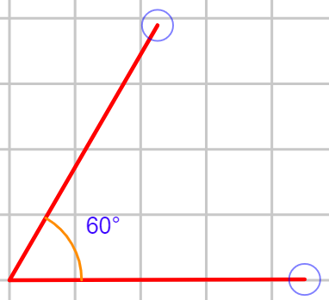
Optimal Projection 2
You will “put” the “shot” using 3 different release angles.
Rest between attempts.
Use the movement analysis app to verify each attempt’s angle.
For each successful attempt (correct angle), record the distance.
Which attempt traveled the furthest?
Modifications
Have landing targets of differing heights. How does this affect the distance
of the throw?
Resource: https://www.youtube.com/watch?v=tujhe7sc7SQ

Slide 5
Optimal Projection 3
You will punt the football (or soccer ball) using 3 different release angles.
Rest between attempts.
Use the movement analysis app to verify each attempt’s angle.
For each successful attempt (correct angle), record the distance and time.
Which attempt traveled the furthest?
Which had the most hang time?

Slide 6
Resistance to Angular Motion
The further the horizontal distance the weight is from the joint that is rotating, the greater the muscular force required to lift the weight.
How much mass and how it is distributed affects resistance to angular velocity (how?)

Slide 7
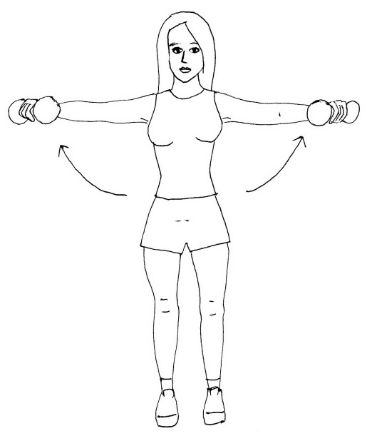
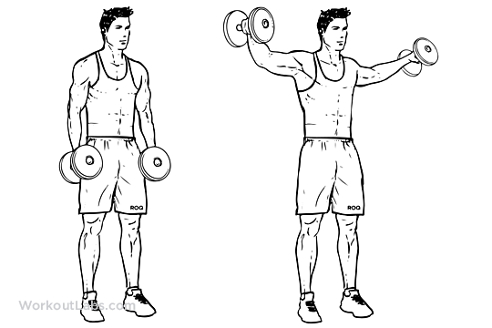
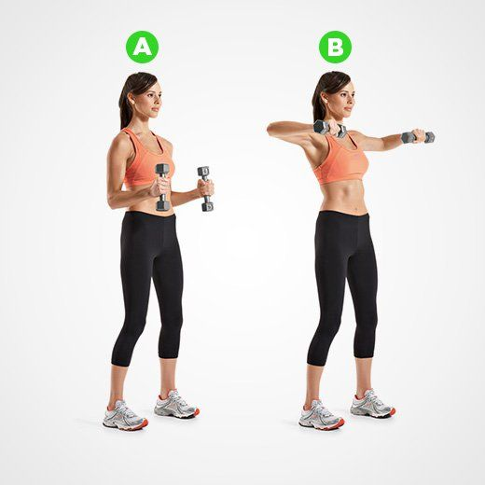
Resistance to Angular Motion 1
Perform lateral side raises using a light weight with the following positions:
Arms Almost Fully Extended (approx. 165 degrees) | Arms Slightly Bent (approx. 120 degrees) | Arms Moderately Bent (approx. 90 degrees)
Which position did the weight feel the lightest? (Position 3 should feel the easiest because the weight being lifted is closer to the joint) Explain the concept of “Moment Arm.” What other examples can you see this principle at work?

Slide 8
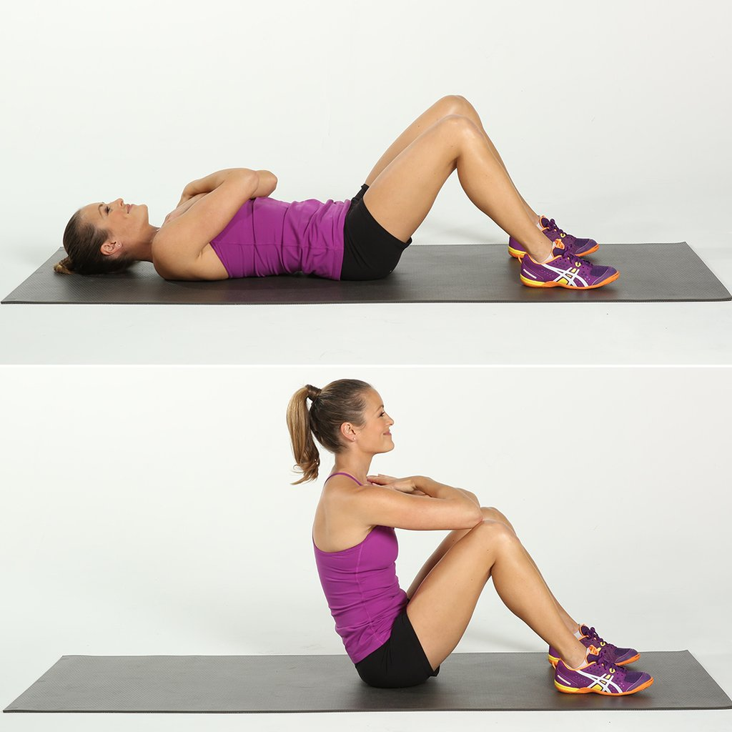
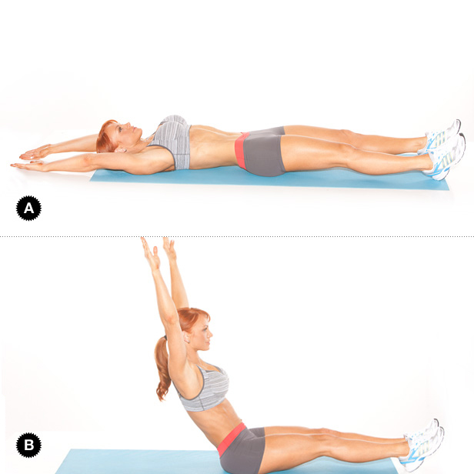
Resistance to Angular Motion 2
Easier Sit-up
Harder Sit-up
Why is the “easier sit-up” easier? (more mass near the axis of rotation) – create picture of harder version with knees bent

Slide 9
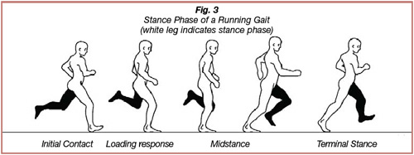
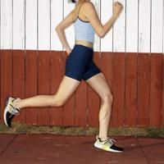
Resistance to Angular Motion 3
Easier Running Technique
Harder Running Technique
Bring legs to butt (reduces force needed for forward swing of leg)
Bring legs to perpendicular to ground

Slide 10
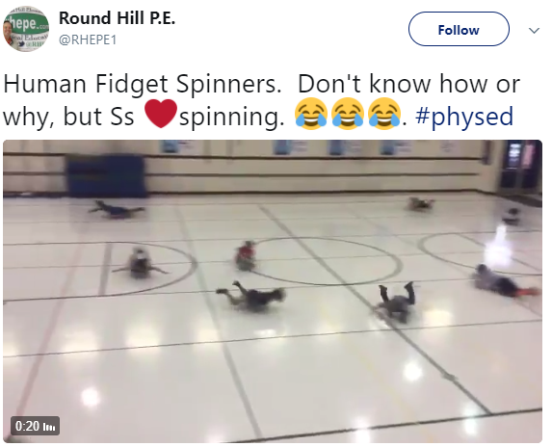
Resistance to Angular Motion 4
Students lay on the scooter board and another student will spin them.
What happens when you put your arms and legs out?
What happens when you put your arms and legs in?

Slide 11
Coordination Continuum
Simultaneous Movement: used in movements that require high forces (preparation, action, and follow through phase occur at almost the same time).
Sequential Interaction (summation of forces): Forces acting on the linked segments of the body can be transferred to other segments. Used in movements that require lower forces and higher speed.

Slide 12
Coordination Continuum 1 - Sequential
You will be shooting a basketball under 3 different conditions and recording the distance and trajectory of the shot.
Position 1 Use arms only. Do not bend your legs or use your calf muscles. | Position 2 Use arms and bend/extend legs. Do not use your calf muscles. | Position 3 Bend and extend your legs before you shoot and push off the ground with your calf muscles.
(insert picture) | (insert picture) | (insert picture)
Which lab were you the most successful? How did each lab feel?

Slide 13
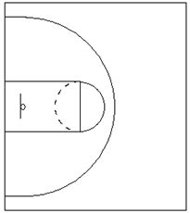
Coordination Continuum 1 Recording Sheets
Place an “X” where the ball landed
(use different colors for each attempt)
Draw the trajectory
(use different colors for each attempt)

Slide 14
Coordination Continuum 2 - Sequential
Each partner will throw a ball as far as they can for each portion of the lab. The non-throwing partner will record the distance thrown.
Sitting position 1.
Have your partner hold your shoulders so that you cannot twist your upper body.
Throw the ball as far as you can, using only your arm to generate force.
Record the distance: _____________
Sitting position 2.
Do not hold the thrower’s shoulders.
Reaching as far back as you can with your throwing arm, throw the ball as far as you can.
Record the distance: _____________
Standing up 1.
Face the direction you are throwing.
Have your partner hold your shoulders so that you cannot twist your body.
Throw the ball as far as you can, using only your arm to generate force.
Record the distance: _____________
Standing up 2.
Face sideways to the direction you are throwing.
Reaching as far back as you can with your throwing arm, throw the ball as far as you can.
Try to transfer your weight from your back leg to your front leg as you throw.
Record the distance: _____________
Which lab section did you feel the most comfortable throwing?
Which lab section did you throw the furthest?

Slide 15
Coordination Continuum 3
Students practice a jump shot from numerous distances from the basket.
Start at the closest location. At each location, attempt:
Shooting the basketball using a slow segmental approach.
Shooting the basketball using a simultaneous approach.
The further away they get, the more simultaneous the shooting movement must be (in order to generate enough force).

Slide 16
Coordination Continuum 4
Jump for maximum height using both approaches.
Record your score.
Did you jump higher using a sequential technique or simultaneous?

Slide 17
Friction 1
How does equipment affect performance?
Wheels (skateboard, inline skates, etc.)
Shoes/Cleats
Playing Surface
Tennis courts (regular, clay, grass)
Skating surface (asphalt, concrete, wood, indoor flooring, etc.)
Grass vs turf

Slide 18
Friction 2
Push a heavy object using 2 different methods (or pulling – think Crossfit):
Continuously bumping object forward
Sliding object as far as you can, rest and repeat
Which method was easier?

Slide 19
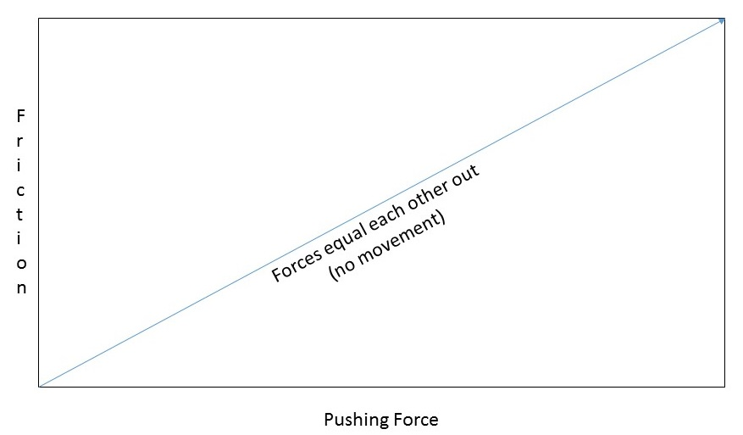
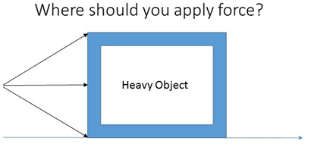
Friction 3
Try moving an object, applying the force in different locations (see below)
Which method was easiest to move the object?

Slide 20
Buoyancy
The amount of buoyant force is equal to the amount of water displaced (dependent on volume of object) by the object.
Person’s ability to float also depends on aligning buoyant force (BF) or center of buoyancy (near the center of the chest) with the center of gravity of the body (near the belly button in anatomical position).

Slide 21
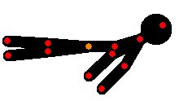
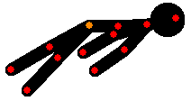
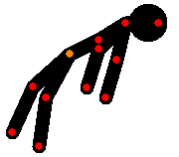
Buoyancy 1
Laying in the water, try to stay afloat using these 3 positions:
Position 1 Head is out of water. Back is parallel to water line. Legs are near the top of the water. | Position 2 Head is halfway out of the water. Back is parallel to water line Legs are relaxed. | Position 3 Water is covering half the head, from ears back. Back and legs are relaxed and in a reclined position.
Which position was the easiest to stay afloat? (Position 3 should be the easiest because the more water displaced, the more buoyancy created)

Slide 22
Buoyancy 2
When floating, inhale the maximum amount of air.
Now exhale the maximum amount of air.
What happens? Which makes it easier to float.

Slide 23
Form Drag 1
Decreasing frontal area and streamlining (biking, skating, what else?). Activity can be generic. Can also add additional clothing to students to increase drag.

Slide 24
Form Drag 2
Swimming: hand enters water at different positions
palm down
palm 45 degrees
and palm perpendicular to water line

Slide 25
Force-Time 1 (Impulse)
Practice increase time that force is applied in order to slow down object:
Landing, catching a baseball, receiving hockey pass, trapping a soccer ball, etc.
Was it easier or harder to execute the skill with longer time applying force or shorter time? What did it feel like?

Slide 26
Force-Time 2 (Impulse)
Increase time that force is applied in order to increase total exerted impulse (i.e., a bigger change in speed)
Practice skills with and without following through (shooting a basketball, kicking a soccer ball, throwing a ball, etc.)
Ie. Penalty kick in soccer (shooting from a straight approach vs shooting from an angled approach – which maximizes hip rotation and allows for further follow through)
Measure the distance for each (multiple attempts and average)
Measure time from “release to target”

Slide 27
Principle of Balance – Base of Support
Wrestling Activity: students attempt to get their partner off balance by pushing against each other. Switch roles after 3 attempts.
Option 1: Provide different tactics
Narrow base vs Wide base
Staggered stance versus non-staggered stance
Option 2: Don’t provide any information and let the students practice their own ideas. Debrief after the task: What worked and what didn’t?

Slide 28
Principle of Balance 2 – Base of Support
Modify Yoga positions with greater base of support vs smaller base of support

Slide 29
Spin
The rotation of projectiles can be used to stabilize flight, modify flight, and modify rebound.
More spin = less speed
Surprising Applications of the Magnus Effect video - https://www.youtube.com/watch?v=2OSrvzNW9FE&list=PLf_5SaJu-WJRlXEvKWG7N-f4P0oI0Z5Ld&index=7

Slide 30
Spin
Activity for modifying rebound: bounce pass a basketball using topspin and sidespin
Activity for modifying flight path: “Bending” a soccer shot.
Activity for modifying flight path: Volleyball serve (regular, float, and topspin)
Activity for stabilizing flight: Frisbee (Turbo put: try pushing only and try pushing and spinning) and football pass (no rotation vs spiral)

